Slide 1




Continuously Integrated Microwave Antenna Holography
Chance Lawrence (UA)
Mentors: Dr. Michael Parker and Joel Huebner (RRC)
Arizona NASA Space Grant Statewide Research Symposium
April 20th, 2024
Partner

Slide 2
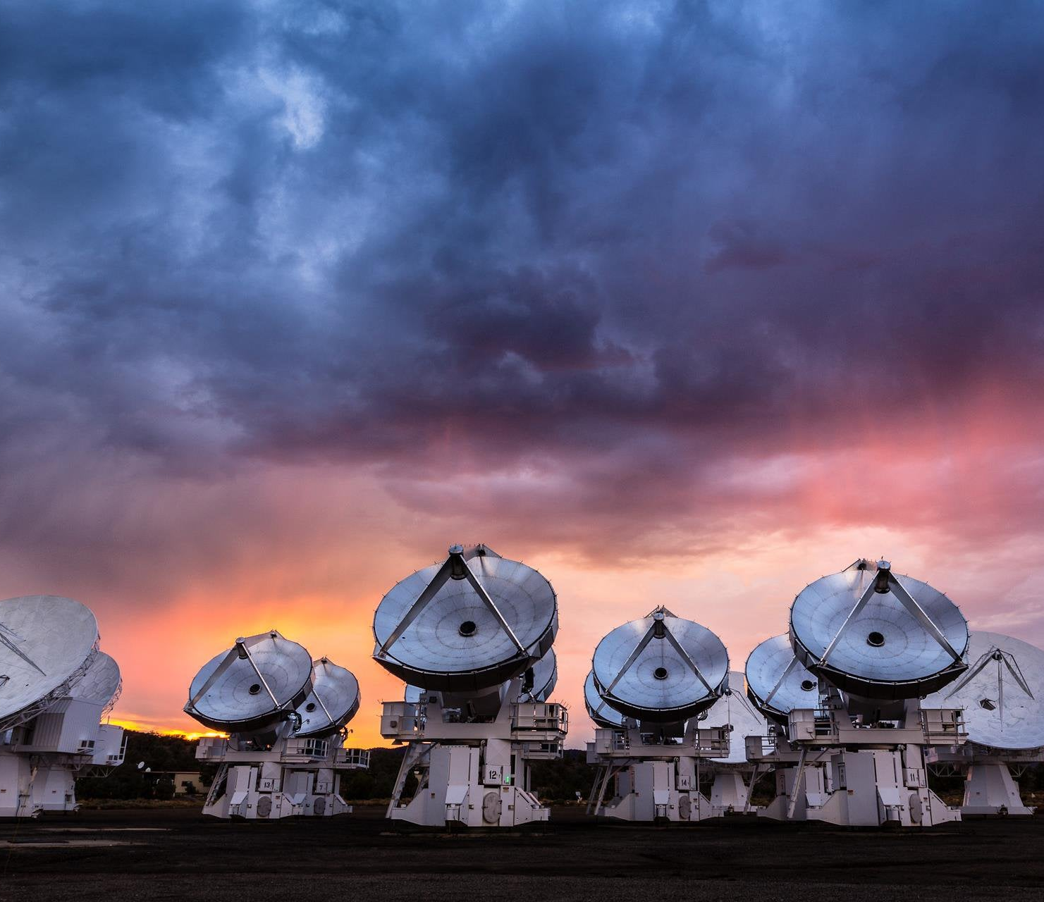
New Equipment
Xband communication
New cubesat missions
CatSat
Low end of operating freq
Notes:
Xband = 8-12 GHz
Government bands (S,X,Ka)
CatSat: Video streaming from 6U spacecraft along with ionospheric radio sounding (shoot a beam out, bounce it off the ionosphere, record the return wave properties to get height and electron density)

Slide 3
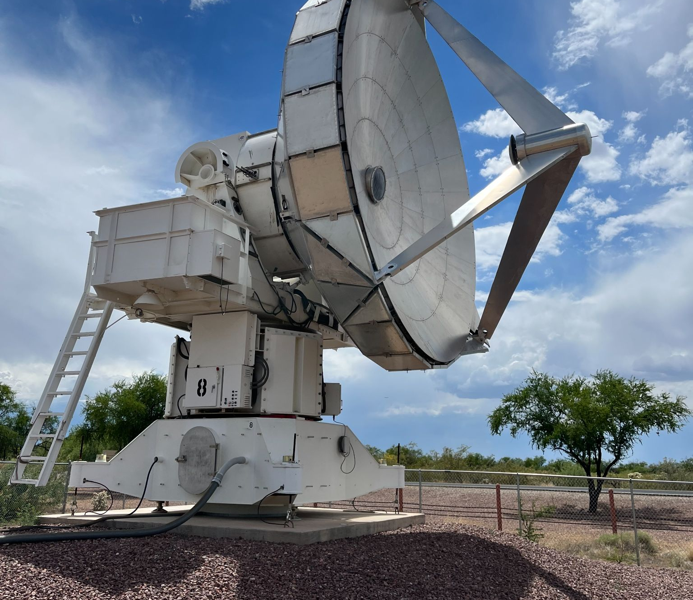
The Need for Accuracy
6.1-m diameter
Reported 42µm RMS Surface Error
Moved from original location
Inyo Mtn, CA.
Notes:
42 micrometer root mean square surface shape error: average of 42 micrometers off from being perfectly curved (when manufactured)
97% ruze efficiency
Surface error must be no greater than

Slide 4
Objective
Determine the current state of the main reflector surface
Identify surface imperfections

Slide 5
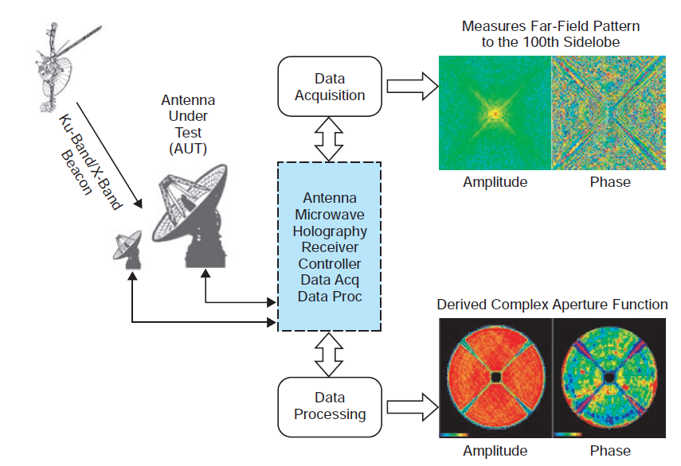
Antenna Holography
Two antenna
Continuous Wave (CW) Source
Measurements of phase and amplitude
Compare
Phase amplitude maps
Reid, Macgregor S. Low-Noise Systems in the Deep Space Network, Jet Propulsion Laboratory, 29 Sept. 2008

Slide 6
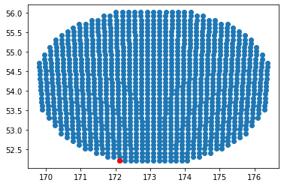
Antenna Positioning Software
Commanded Az-El Coords
Preexisting software
Corona
Antpos
Implement raster scan
Point by point
El
Az
Notes:
Raster scan (capturing an image line by line)

Slide 7
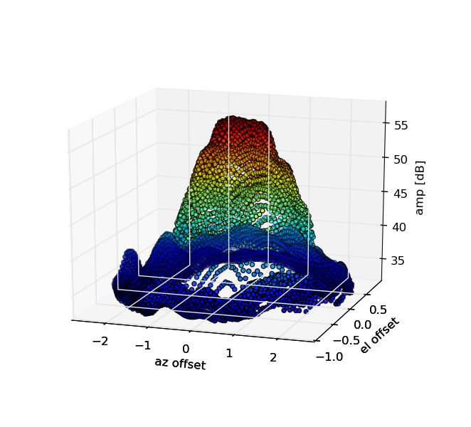
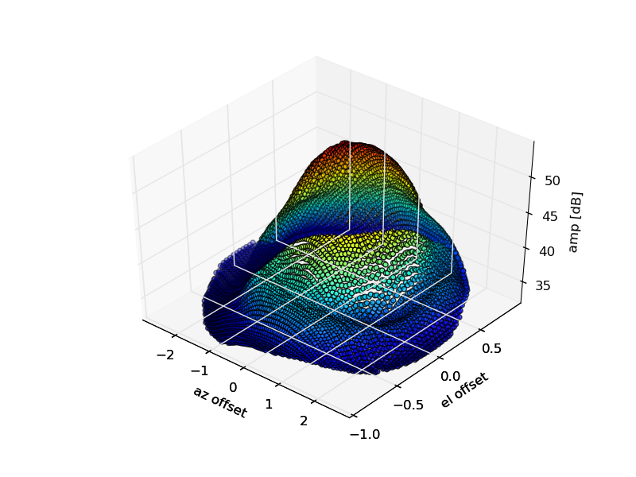
The Need, the Need for Speed
Way too slow
Continuous integration
Scan time nearly split in half!
No pointing model
No servo calibration

Slide 8
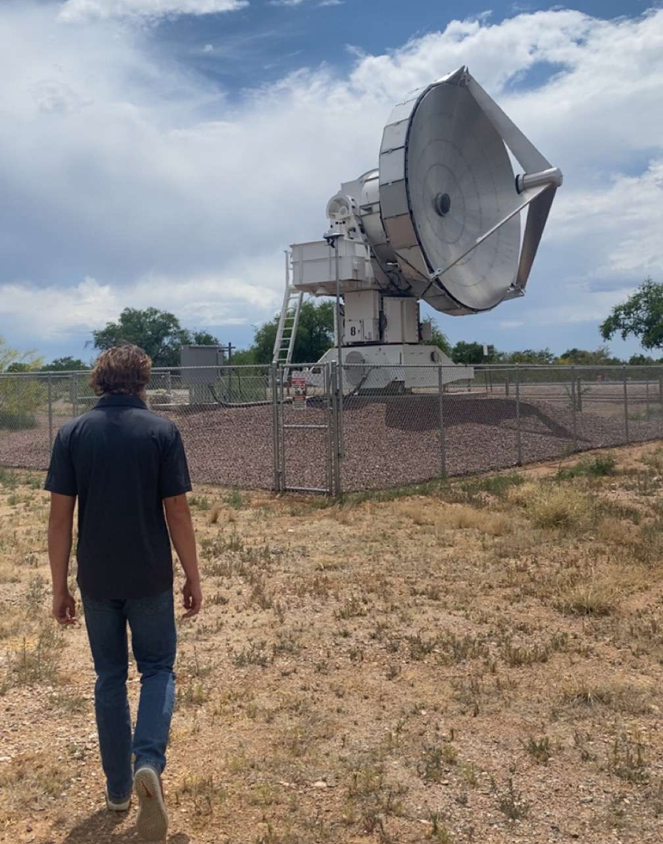
Future Use
Utilize software
Add in-track and cross-track
Waiting for repairs
Focus motor

Slide 9
Partner
Thank You

Slide 10
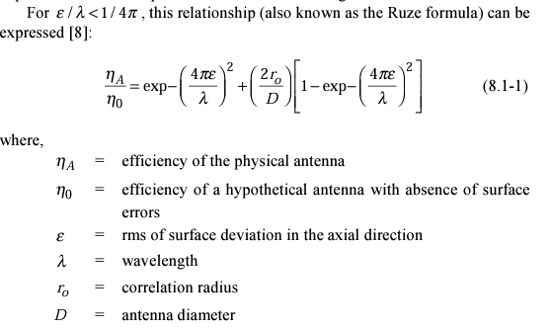
Reid, Macgregor S. Low-Noise Systems in the Deep Space Network, Jet Propulsion Laboratory, 29 Sept. 2008

Slide 11


Mathematical Expressions for Data Processing
Far Field Radiation Pattern
Residual Normal Surface Error
Reid, Macgregor S. Low-Noise Systems in the Deep Space Network, Jet Propulsion Laboratory, 29 Sept. 2008

Slide 12
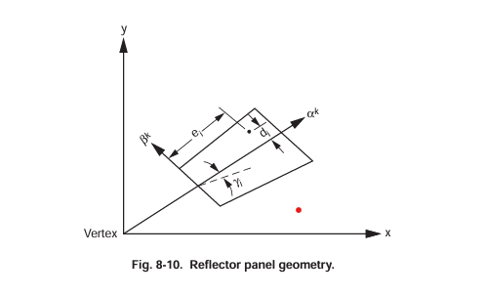
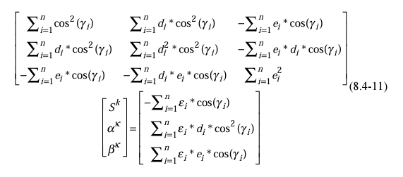
Reflector Panel Geometry
Reid, Macgregor S. Low-Noise Systems in the Deep Space Network, Jet Propulsion Laboratory, 29 Sept. 2008

